Slide 1
Chapter 1: Introduction to Computer Sciences
University of Badji Mokhtar Annaba
Faculty of Sciences
Department of Mathematics and Computer Sciences
Module: TCE (Englsih)
Prepared by: Miss BOUMAZA Chaima 2021/2022

Slide 2
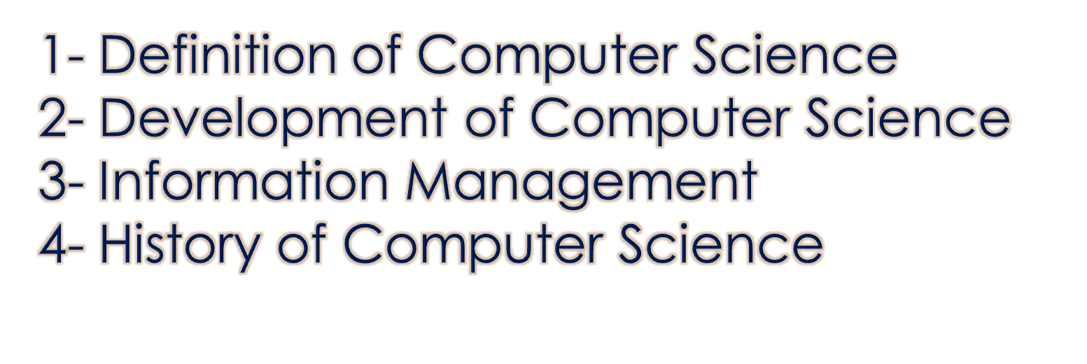
OUTLINE

Slide 3
1- Definition of Computer Science :
Computer science, the study of computers and computing, including their theoretical and algorithmic foundations, hardware and software, and their uses for processing information.

Slide 4
2- Development Of Computer Science :
Computer science emerged as an independent discipline in the early 1960s, although the electronic digital computer that is the object of its study was invented some two decades earlier. The roots of computer science lie primarily in the related fields of mathematics, electrical engineering, physics, and management information systems.
In the 1950s, most computer users worked either in scientific research labs or in large corporations. The former group used computers to help them make complex mathematical calculations, while the latter group used computers to manage large amounts of corporate data.

Slide 5
3-Information Management :
Information management (IM) is primarily concerned with the capture, digitization, representation, organization, transformation, and presentation of information. Because a computer’s main memory provides only temporary storage, computers are equipped with auxiliary disk storage devices that permanently store data. These devices are characterized by having much higher capacity than main memory but slower read/write (access) speed. Data stored on a disk must be read into main memory before it can be processed.

Slide 6
4- History of Computer Science :
Computer has become an indispensable and multipurpose tool. We are breathing in the computer age and gradually computer has become such a desire necessity of life that it is difficult to imagine life without it.
It has been developing since early age, and still under developement..

Slide 7
4- History of Computer Science :
1822: English mathematician Charles Babbage conceives of a steam-driven calculating machine that would be able to compute tables of numbers. The project, funded by the English government, is a failure. More than a century later, however, the world's first computer was actually built.
1937: J.V. Atanasoff, a professor of physics and mathematics at Iowa State University, attempts to build the first computer without gears, cams, belts or shafts.
1999: The term Wi-Fi becomes part of the computing language and users begin connecting to the Internet without wires.
2007: The iPhone brings many computer functions to the smartphone.
2015: Apple releases the Apple Watch. Microsoft releases Windows 10.

